Slide 1
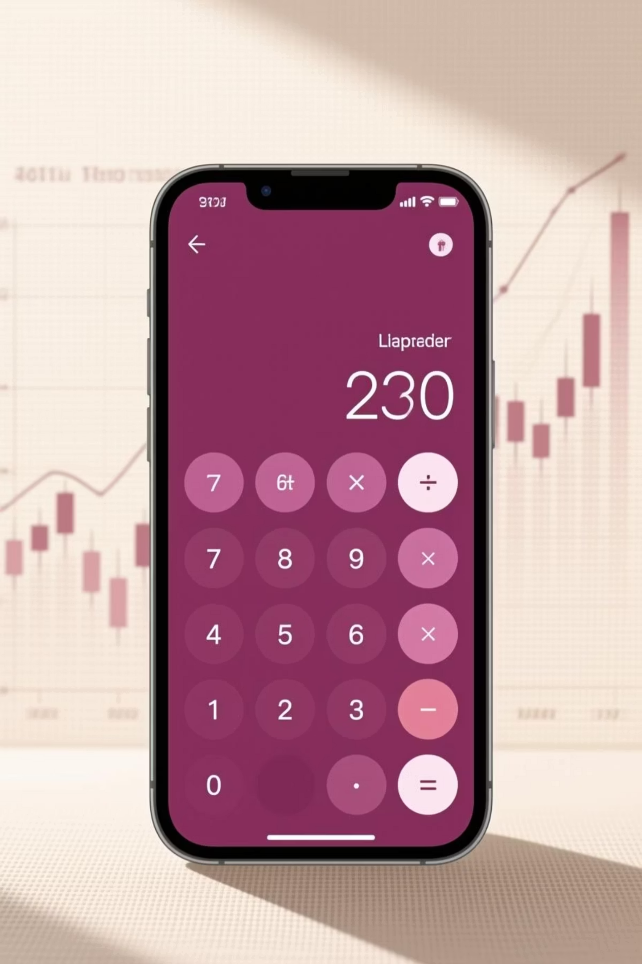
Loan EMI & Interest Calculator
By Pratik Karmakar
Branch: B.TECH CSE (AI/ML)
ERP: RU-25-11000

Slide 2
Project Overview & Agenda
Project Name
Loan EMI & Interest Calculator
Introduction
Understand loans, EMIs, and their financial significance.
Tools Used
Explore the technologies behind the calculator's development.
Project Working
Dive into the mechanics of EMI calculation and output.
Applications
Discover practical uses in personal and institutional finance.
Advantages
Highlight the key benefits of using this tool.
Future Scope
Envision potential enhancements and advanced features.

Slide 3

Understanding Loan EMI & Interest
A Loan EMI & Interest Calculator is an essential financial tool designed to simplify the complex process of estimating monthly loan repayments. It provides users with a clear picture of their financial obligations.
By inputting key details such as the loan amount, interest rate, and loan tenure, the calculator swiftly computes the Equated Monthly Installment (EMI) along with the total interest payable over the loan period.
This proactive approach enables borrowers to understand repayment structures, compare various loan products, and make informed financial decisions before committing to a loan.

Slide 4



Tools & Technology Utilized
Programming Language
Integrated Development Environment (IDE)
Libraries & Frameworks
Developed using C language for its efficiency and foundational capabilities in system programming.
Incorporated standard C libraries, particularly math.h, for complex mathematical operations required in EMI calculations.
Leveraged VS Code for its robust features, debugging tools, and extensive customization options, enhancing productivity.
Our calculator combines foundational programming principles with modern development practices to ensure accuracy and a smooth user experience.

Slide 5
The Code: Initial Setup
#include <math.h> #include <stdio.h> int main() { double principal, annualRate, monthlyRate, emi, totalPayment, totalInterest; int years, totalMonths, i; double interestPaid, principalPaid, remainingBalance; // Input printf("Enter Principal Amount: "); if (scanf("%lf", &principal) != 1 || principal <= 0) { printf("Invalid input for Principal.\n"); return 1; } printf("Enter Annual Interest Rate (%%): "); if (scanf("%lf", &annualRate) != 1 || annualRate < 0) { printf("Invalid input for Interest Rate.\n"); return 1; } printf("Enter Tenure (in years): "); if (scanf("%d", &years) != 1 || years <= 0) { printf("Invalid input for Tenure.\n"); return 1; }

Slide 6
The Code: Calculation & Summary
// Calculations monthlyRate = annualRate / (12 * 100); totalMonths = years * 12; if (annualRate == 0) { emi = principal / totalMonths; totalPayment = principal; totalInterest = 0; } else { // EMI Formula: E = P * r * (1+r)^n / ((1+r)^n - 1) emi = principal * monthlyRate * pow(1 + monthlyRate, totalMonths) / (pow(1 + monthlyRate, totalMonths) - 1); totalPayment = emi * totalMonths; totalInterest = totalPayment - principal; } // Output Summary printf("\n--- Loan Summary ---\n"); printf("Principal Amount: %.2lf\n", principal); printf("Annual Interest Rate: %.2lf%%\n", annualRate); printf("Tenure: %d years (%d months)\n", years, totalMonths); printf("Monthly EMI: %.2lf\n", emi); printf("Total Interest Payable: %.2lf\n", totalInterest); printf("Total Payment (Principal + Interest): %.2lf\n", totalPayment); // Amortization Schedule printf("\n--- Amortization Schedule ---\n"); printf("%-6s | %-15s | %-12s | %-12s | %-15s | %-15s\n", "Month", "Opening Bal", "EMI", "Interest", "Principal", "Closing Bal"); printf("---------------------------------------------------------------------");

Slide 7
The Code: Amortization Schedule & Exit
-------------------\n"); remainingBalance = principal; for (i = 1; i <= totalMonths; i++) { double openingBalance = remainingBalance; double currentEMI = emi; interestPaid = openingBalance * monthlyRate; principalPaid = currentEMI - interestPaid; // Adjust for last month to ensure exact closure if (i == totalMonths || principalPaid > openingBalance) { principalPaid = openingBalance; currentEMI = principalPaid + interestPaid; remainingBalance = 0; } else { remainingBalance = openingBalance - principalPaid; } printf("%-6d | %-15.2lf | %-12.2lf | %-12.2lf | %-15.2lf | %-15.2lf\n", i, openingBalance, currentEMI, interestPaid, principalPaid, remainingBalance); } // Keep window open if run directly printf("\nPress Enter to exit..."); getchar(); // Consume newline from last scanf getchar(); // Wait for key press return 0; }

Slide 8




How the Project Works
User Input
The user provides essential loan details: principal amount, annual interest rate, and loan tenure in years.
EMI Calculation
Using the standard EMI formula, the program computes the Equated Monthly Installment based on the provided inputs.
Result Display
Outputs include the monthly EMI, total interest payable, and the total amount (principal + interest) to be repaid.
The calculator offers a detailed amortization schedule, breaking down each monthly payment into principal and interest components.

Slide 9

Project Working

Slide 10








Diverse Applications
Personal Loan Planning
Banks & Financial Institutions
Helps individuals plan for personal loans, home loans, and vehicle financing by estimating monthly payments.
Used by lenders to quickly provide loan estimates to clients, streamlining their service offerings.
Business Loan Estimation
Financial Education
Assists small and large enterprises in forecasting loan repayments for business expansion or operational costs.
Aids in budgeting and financial literacy, allowing users to understand the long-term impact of interest and repayment schedules.

Slide 11





Key Advantages of the Calculator
Accuracy
Provides precise EMI and interest calculations, minimizing human error.
User-Friendly Interface
Simple and intuitive design makes it accessible for all users, regardless of financial expertise.
Time-Saving
Automates complex calculations, saving valuable time for both individuals and financial professionals.
Enhanced Financial Planning
Empowers users to make informed decisions by clearly visualizing repayment obligations and total costs.
This tool is an invaluable asset for anyone looking to manage their finances more effectively and understand loan commitments transparently.

Slide 12



Future Scope
Integration with AI
Mobile Accessibility
Multi-currency Support
Predictive analytics for loan recommendations.
Dedicated applications for iOS and Android.
Expanding to international markets.

